Slide 1
Environment API
Gym environment
https://gymnasium.farama.org/
Environments will have reset(), which returns state,
And step(), which returns state, reward, terminated, truncated, info

Slide 2
Scenario 1: Oscillator suppression
Original paper for the gym environment:
https://arxiv.org/abs/2002.10948
Our work is in prep as part of the larger project

Slide 3
Scenario 1 – Intro
Environment mechanism: correlated Bonhoeffer–van der Pol oscillators.
Biological significance: This is argued to be similar to the underlying mechanism of Parkison's Disease

Slide 4
Scenario 1 – Observation
The observation given to the agent is the mean field signal (average activation of all neurons), along with its history

Slide 5

Scenario 1 – Reward
The reward is given based on how close the agent can make the system approach the average of the sliding window.
This window is the exact window given in observation
With a penalty on action
Calculated as a known function based on state and action

Slide 6
Scenario 1 – Action Space
The action is modeled as a voltage applied to the system globally at each timestep
One dimensional; continuous; can be positive or negative; bounded
No delay between observation and action is introduced

Slide 7
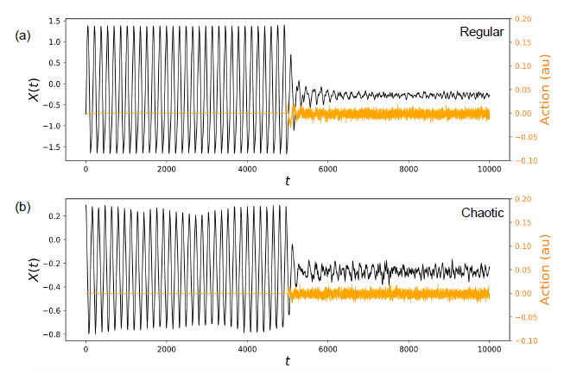
Expected outcome

Slide 8
Scenario 1 – Adaptations
Updated to newer gym version: done -> terminated, truncated

Slide 9
Scenario 2: VNS cardiac modulation
https://iopscience.iop.org/article/10.1088/1741-2552/ad48bb

Slide 10
Scenario 2 – Intro
We trained a TCN model based on the original Matlab ODE simulation
MAP and HR modulation

Slide 11
Scenario 2 – Observation
The observation given to the agent is the MAP and HR stats

Slide 12

Scenario 2 – Reward
Reward is given to how close the agent can push the system to its set point

Slide 13
Scenario 2 – Action Space
6 dimensional; continuous; bounded
Representing VNS stimulation at 3 locations

Slide 14
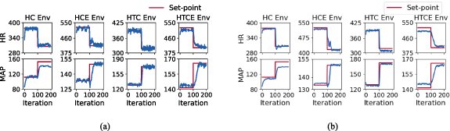
Expected outcome

Slide 15
Scenario 2 – Adaptations
Using pre-trained TCN model
Updated to newer gym version: done -> terminated, truncated

Slide 16
Scenario 3: Epilepsy Suppression
TVB Epileptor & stimulation
Paper for TVB
https://www.frontiersin.org/journals/neuroinformatics/articles/10.3389/fninf.2013.00010/full
Paper for the specific epilepsy model
https://academic.oup.com/brain/article/137/8/2210/2847958
Specific tutorial used for this course
https://github.com/the-virtual-brain/tvb-root/blob/master/tvb_documentation/tutorials/tutorial_s6_ModelingEpilepsy.ipynb
Part of my ongoing work

Slide 17
Epilepsy model detail
"We will model a patient with temporal lobe epilepsy (TLE). We will set different values of epileptogenicity x0 parameter in the Epileptor according to the region positions, thereby introducing heterogeneities in the network parameters. We set the right limbic areas (right hippocampus (rHC, region 47), parahippocampus (rPHC, region 62) and amygdala (rAMYG, region 40)) as epileptic zones. We also add two lesser epileptogenic regions: the superior temporal cortex (rTCI, region 69) and the ventral temporal cortex (rTCV, region 72).
In other words, we assign to all the nodes the Dynamics for which x0 has a value of value of −2.2. We apply the epileptogenic configuration (−1.6) to the right limbic areas.
Additionally, we chose which kind of coupling we want (between the fast variable (Kvf), the spike-and-wave events (Kf), or the slow permittive coupling (Ks)). Here we use Kf and Ks of them.
Finally, we also slow-down the dynamics of the Epileptor by choosing r=0.00015"

Slide 18
Scenario 3 – Observation
The observation given to the agent is EEG observation of 65 electrodes of past 2 secs, with fs=1000Hz
EEG signal is normalized by (EEG – mean) / (max – min) for each individual channel over the 2sec window
The system runs for a little bit (4secs) to generate history and reach initial stabilization before agent kicks in
Each iteration the simulation runs for a fixed timelength (default=10ms), and the agent can update its control

Slide 19
Scenario 3 – Reward
The reward is given based on suppression of epileptic activity

Slide 20
Scenario 3 – Action Space
The action is modeled as a voltage applied to the system at the lesser epileptic brain areas – the superior temporal cortex (rTCI, region 69) and the ventral temporal cortex (rTCV, region 72).
One dimensional; bounded; positive or negative

Slide 21
Expected outcome
This is the more open problem!

Slide 22
Scenario 3 – Adaptations
I chose the simulator model, stimulation
Writing the gym wrapper
A lot of work under the hood to interact with the simulation
The simulation itself can be slow (which was our motivation to use data driven model in scenario 2)

